Slide 1
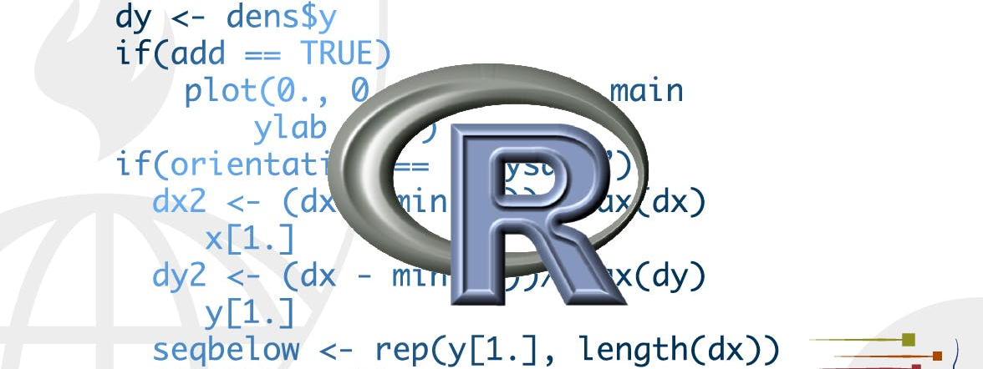
Tidy data
STA 4233 Introduction to Programming and Data Management in R
Notes:
In this lecture, you will learn a consistent way to organise your data in R, an organisation called tidy data. Getting your data into this format requires some upfront work, but that work pays off in the long term. Once you have tidy data and the tidy tools provided by packages in the tidyverse, you will spend much less time munging data from one representation to another, allowing you to spend more time on the analytic questions at hand.
This chapter will give you a practical introduction to tidy data and the accompanying tools in the tidyr package.

Slide 2
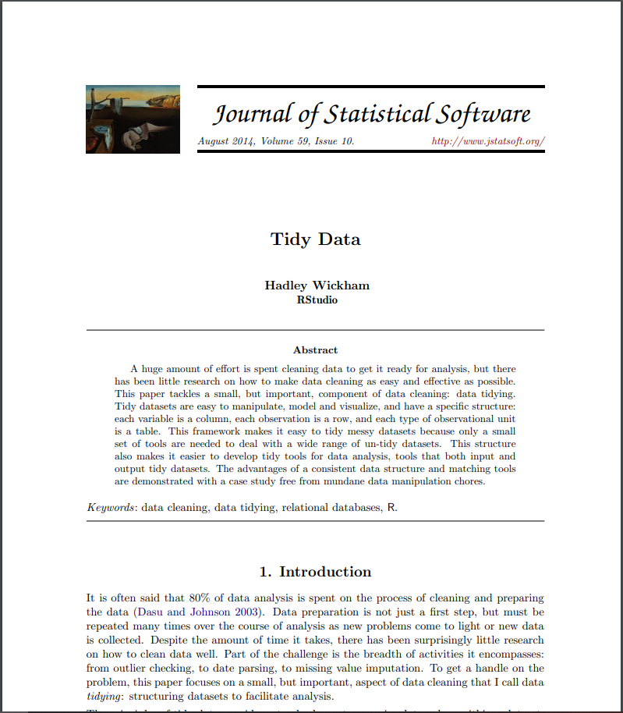
Tidy data
http://www.jstatsoft.org/v59/i10/paper.
Notes:
If you’d like to learn more about the underlying theory, you might enjoy the Tidy Data paper published in the Journal of Statistical Software, http://www.jstatsoft.org/v59/i10/paper.

Slide 3
Tidy data
table1
#> # A tibble: 6 x 4
#> country year cases population
#> <chr> <int> <int> <int>
#> 1 Afghanistan 1999 745 19987071
#> 2 Afghanistan 2000 2666 20595360
#> 3 Brazil 1999 37737 172006362
#> 4 Brazil 2000 80488 174504898
#> 5 China 1999 212258 1272915272
#> 6 China 2000 213766 1280428583
table2
#> # A tibble: 12 x 4
#> country year type count
#> <chr> <int> <chr> <int>
#> 1 Afghanistan 1999 cases 745
#> 2 Afghanistan 1999 population 19987071
#> 3 Afghanistan 2000 cases 2666
#> 4 Afghanistan 2000 population 20595360
#> 5 Brazil 1999 cases 37737
#> 6 Brazil 1999 population 172006362
#> # … with 6 more rows
Notes:
You can represent the same underlying data in multiple ways. The example below shows the same data organised in four different ways. Each dataset shows the same values of four variables country, year, population, and cases, but each dataset organises the values in a different way.

Slide 4
Tidy data
table3
#> # A tibble: 6 x 3
#> country year rate
#> * <chr> <int> <chr>
#> 1 Afghanistan 1999 745/19987071
#> 2 Afghanistan 2000 2666/20595360
#> 3 Brazil 1999 37737/172006362
#> 4 Brazil 2000 80488/174504898
#> 5 China 1999 212258/1272915272
#> 6 China 2000 213766/1280428583
# Spread across two tibbles
table4a # cases
#> # A tibble: 3 x 3
#> country `1999` `2000`
#> * <chr> <int> <int>
#> 1 Afghanistan 745 2666
#> 2 Brazil 37737 80488
#> 3 China 212258 213766
table4b # population
#> # A tibble: 3 x 3
#> country `1999` `2000`
#> * <chr> <int> <int>
#> 1 Afghanistan 19987071 20595360
#> 2 Brazil 172006362 174504898
#> 3 China 1272915272 1280428583
Notes:
These are all representations of the same underlying data, but they are not equally easy to use. One dataset, the tidy dataset, will be much easier to work with inside the tidyverse.

Slide 5
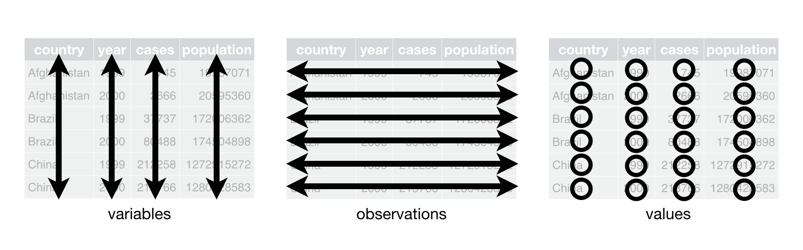
Tidy data
Each variable must have its own column.
Each observation must have its own row.
Each value must have its own cell.
Notes:
There are three interrelated rules which make a dataset tidy:
Each variable must have its own column.
Each observation must have its own row.
Each value must have its own cell.
Following three rules makes a dataset tidy: variables are in columns, observations are in rows, and values are in cells.
These three rules are interrelated because it’s impossible to only satisfy two of the three. That interrelationship leads to an even simpler set of practical instructions:
Put each dataset in a tibble.
Put each variable in a column.

Slide 6
Tidy data
table1
#> # A tibble: 6 x 4
#> country year cases population
#> <chr> <int> <int> <int>
#> 1 Afghanistan 1999 745 19987071
#> 2 Afghanistan 2000 2666 20595360
#> 3 Brazil 1999 37737 172006362
#> 4 Brazil 2000 80488 174504898
#> 5 China 1999 212258 1272915272
#> 6 China 2000 213766 1280428583
Notes:
In this example, only table1 is tidy. It’s the only representation where each column is a variable.
Why ensure that your data is tidy? There are two main advantages:
There’s a general advantage to picking one consistent way of storing data. If you have a consistent data structure, it’s easier to learn the tools that work with it because they have an underlying uniformity.
There’s a specific advantage to placing variables in columns because it allows R’s vectorized nature to shine. As you learned in mutate and summary functions, most built-in R functions work with vectors of values. That makes transforming tidy data feel particularly natural.

Slide 7
Tidy data
# Compute rate per 10,000
table1 %>%
mutate(rate = cases / population * 10000)
#> # A tibble: 6 x 5
#> country year cases population rate
#> <chr> <int> <int> <int> <dbl>
#> 1 Afghanistan 1999 745 19987071 0.373
#> 2 Afghanistan 2000 2666 20595360 1.29
#> 3 Brazil 1999 37737 172006362 2.19
#> 4 Brazil 2000 80488 174504898 4.61
#> 5 China 1999 212258 1272915272 1.67
#> 6 China 2000 213766 1280428583 1.67
Notes:
dplyr, ggplot2, and all the other packages in the tidyverse are designed to work with tidy data. Here are a couple of small examples showing how you might work with table1.

Slide 8
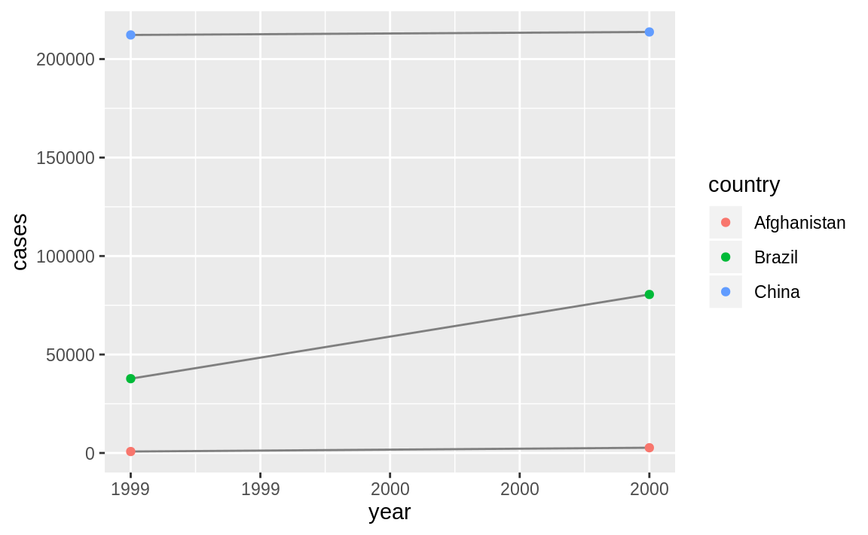
Tidy data
# Compute cases per year
table1 %>%
count(year, wt = cases)
#> # A tibble: 2 x 2
#> year n
#> <int> <int>
#> 1 1999 250740
#> 2 2000 296920
# Visualise changes over time
library(ggplot2)
ggplot(table1, aes(year, cases)) +
geom_line(aes(group = country), colour = "grey50") +
geom_point(aes(colour = country))

Slide 9
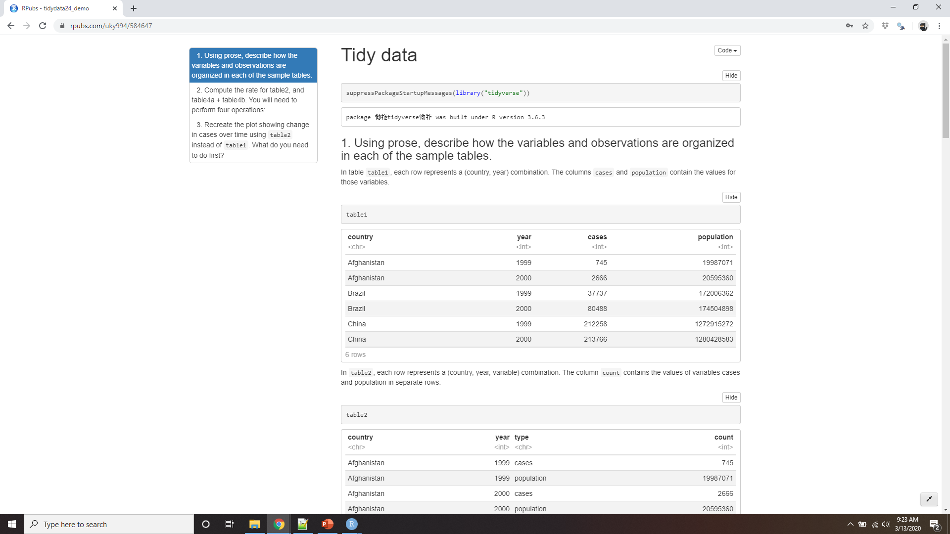
Demo Tidy data
Notes:
https://rpubs.com/uky994/584647
Using prose, describe how the variables and observations are organised in each of the sample tables.
Compute the rate for table2, and table4a + table4b. You will need to perform four operations:
Extract the number of TB cases per country per year.
Extract the matching population per country per year.
Divide cases by population, and multiply by 10000.
Store back in the appropriate place.
Which representation is easiest to work with? Which is hardest? Why?
Recreate the plot showing change in cases over time using table2 instead of table1. What do you need to do first?

Slide 10
Pivoting
Most data that you will encounter will be untidy
For most analyses, you’ll need to do some tidying.
Figure out what the variables and observations are
Two common problems:
One variable might be spread across multiple columns.
One observation might be scattered across multiple rows.
pivot_longer()
and
pivot_wider().
Notes:
The principles of tidy data seem so obvious that you might wonder if you’ll ever encounter a dataset that isn’t tidy. Unfortunately, however, (1) most data that you will encounter will be untidy. There are two main reasons:
Most people aren’t familiar with the principles of tidy data, and it’s hard to derive them yourself unless you spend a lot of time working with data.
Data is often organized to facilitate some use other than analysis. For example, data is often organized to make entry as easy as possible.
(2) This means for most real analyses, you’ll need to do some tidying. (3)The first step is always to figure out what the variables and observations are. Sometimes this is easy; other times you’ll need to consult with the people who originally generated the data. (4) The second step is to resolve one of two common problems:
One variable might be spread across multiple columns.
One observation might be scattered across multiple rows.
Typically a dataset will only suffer from one of these problems; it’ll only suffer from both if you’re really unlucky! (5)To fix these problems, you’ll need the two most important functions in tidyr: pivot_longer() and pivot_wider().

Slide 11
Longer
table4a
#> # A tibble: 3 x 3
#> country `1999` `2000`
#> * <chr> <int> <int>
#> 1 Afghanistan 745 2666
#> 2 Brazil 37737 80488
#> 3 China 212258 213766
Notes:
A common problem is a dataset where some of the column names are not names of variables, but values of a variable. Take table4a: the column names 1999 and 2000 represent values of the year variable, the values in the 1999 and 2000 columns represent values of the cases variable, and each row represents two observations, not one.

Slide 12
longer
table4a %>%
pivot_longer(c(`1999`, `2000`), names_to = "year", values_to = "cases")
#> # A tibble: 6 x 3
#> country year cases
#> <chr> <chr> <int>
#> 1 Afghanistan 1999 745
#> 2 Afghanistan 2000 2666
#> 3 Brazil 1999 37737
#> 4 Brazil 2000 80488
#> 5 China 1999 212258
#> 6 China 2000 213766
Notes:
To tidy a dataset like this, we need to pivot the offending columns into a new pair of variables. To describe that operation we need three parameters:
The set of columns whose names are values, not variables. In this example, those are the columns 1999 and 2000.
The name of the variable to move the column names to. Here it is year.
The name of the variable to move the column values to. Here it’s cases.
Together those parameters generate the call to pivot_longer():

Slide 13
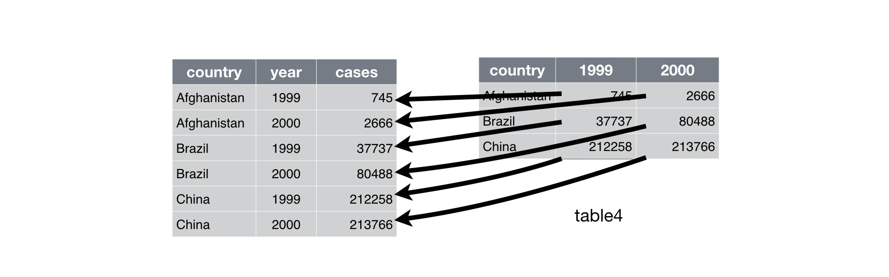
longer
year and cases do not exist in table4a so we put their names in quotes.
Notes:
The columns to pivot are specified with dplyr::select() style notation. Here there are only two columns, so we list them individually. Note that “1999” and “2000” are non-syntactic names (because they don’t start with a letter) so we have to surround them in backticks. To refresh your memory of the other ways to select columns, see select.
In the final result, the pivoted columns are dropped, and we get new year and cases columns. Otherwise, the relationships between the original variables are preserved. Visually, this is shown in Figure 12.2.
pivot_longer() makes datasets longer by increasing the number of rows and decreasing the number of columns. I don’t believe it makes sense to describe a dataset as being in “long form”. Length is a relative term, and you can only say (e.g.) that dataset A is longer than dataset B.

Slide 14
longer
table4b %>% pivot_longer(c(`1999`, `2000`), names_to = "year", values_to = "population") #> # A tibble: 6 x 3
#> country year population
#> <chr> <chr> <int>
#> 1 Afghanistan 1999 19987071
#> 2 Afghanistan 2000 20595360
#> 3 Brazil 1999 172006362
#> 4 Brazil 2000 174504898
#> 5 China 1999 1272915272
#> 6 China 2000 1280428583
Notes:
We can use pivot_longer() to tidy table4b in a similar fashion. The only difference is the variable stored in the cell values:

Slide 15
longer
tidy4a <- table4a %>%
pivot_longer(c(`1999`, `2000`), names_to = "year", values_to = "cases")
tidy4b <- table4b %>%
pivot_longer(c(`1999`, `2000`), names_to = "year", values_to = "population")
left_join(tidy4a, tidy4b)
#> Joining, by = c("country", "year")
#> # A tibble: 6 x 4
#> country year cases population
#> <chr> <chr> <int> <int>
#> 1 Afghanistan 1999 745 19987071
#> 2 Afghanistan 2000 2666 20595360
#> 3 Brazil 1999 37737 172006362
#> 4 Brazil 2000 80488 174504898
#> 5 China 1999 212258 1272915272
#> 6 China 2000 213766 1280428583
Notes:
To combine the tidied versions of table4a and table4b into a single tibble, we need to use dplyr::left_join(), which you’ll learn about in relational data.

Slide 16
Wider
table2
#> # A tibble: 12 x 4
#> country year type count
#> <chr> <int> <chr> <int>
#> 1 Afghanistan 1999 cases 745
#> 2 Afghanistan 1999 population 19987071
#> 3 Afghanistan 2000 cases 2666
#> 4 Afghanistan 2000 population 20595360
#> 5 Brazil 1999 cases 37737
#> 6 Brazil 1999 population 172006362
#> # … with 6 more rows
Notes:
pivot_wider() is the opposite of pivot_longer(). You use it when an observation is scattered across multiple rows. For example, take table2: an observation is a country in a year, but each observation is spread across two rows.

Slide 17
wider
table2 %>%
pivot_wider(names_from = type, values_from = count)
#> # A tibble: 6 x 4
#> country year cases population
#> <chr> <int> <int> <int>
#> 1 Afghanistan 1999 745 19987071
#> 2 Afghanistan 2000 2666 20595360
#> 3 Brazil 1999 37737 172006362
#> 4 Brazil 2000 80488 174504898
#> 5 China 1999 212258 1272915272
#> 6 China 2000 213766 1280428583
Notes:
To tidy this up, we first analyse the representation in similar way to pivot_longer(). This time, however, we only need two parameters:
The column to take variable names from. Here, it’s type.
The column to take values from. Here it’s count.
Once we’ve figured that out, we can use pivot_wider(), as shown programmatically below, and visually in Figure 12.3.

Slide 18
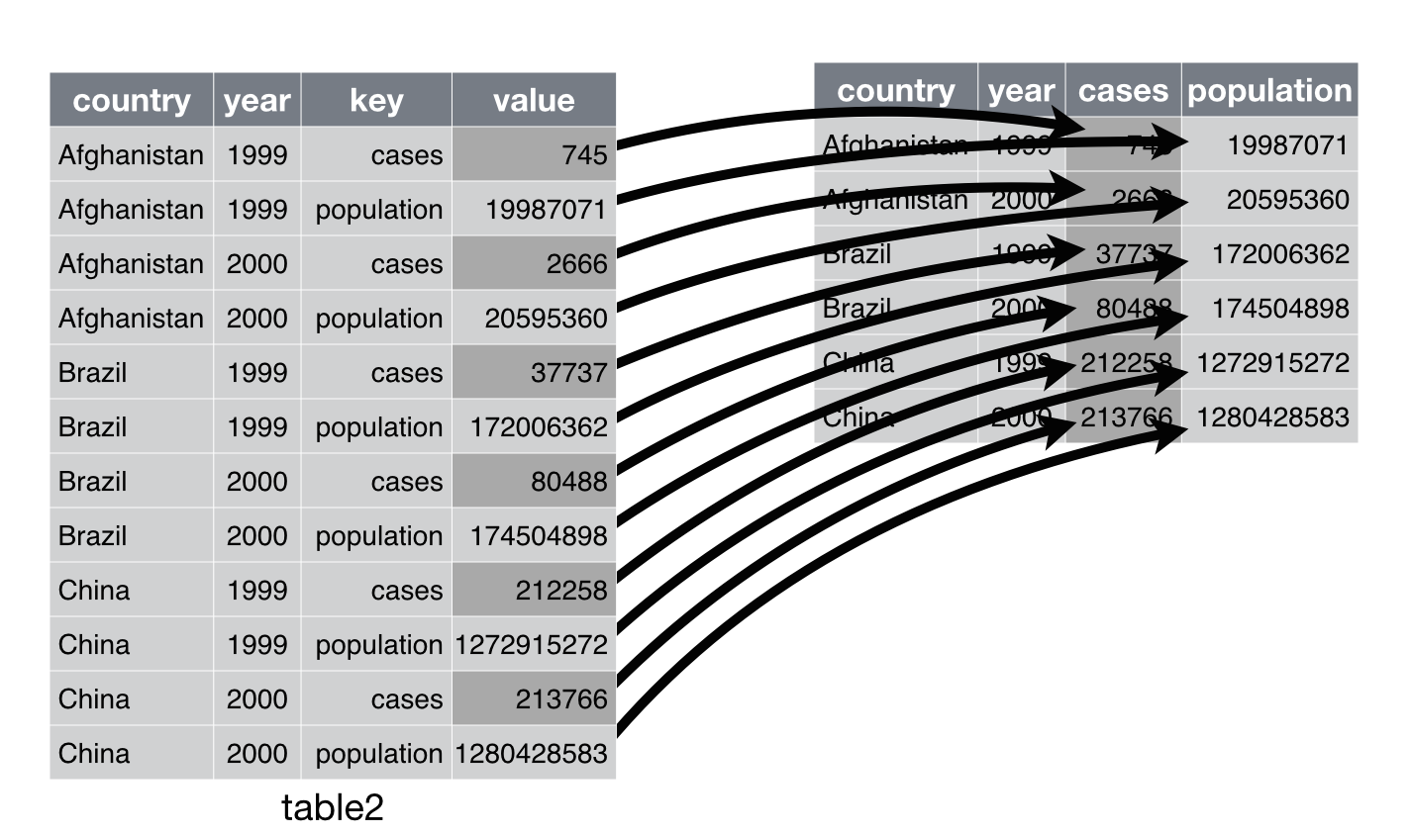
Pivoting table2 into a “wider”, tidy form.
Notes:
As you might have guessed from their names, pivot_wider() and pivot_longer() are complements. pivot_longer() makes wide tables narrower and longer; pivot_wider() makes long tables shorter and wider.

Slide 19
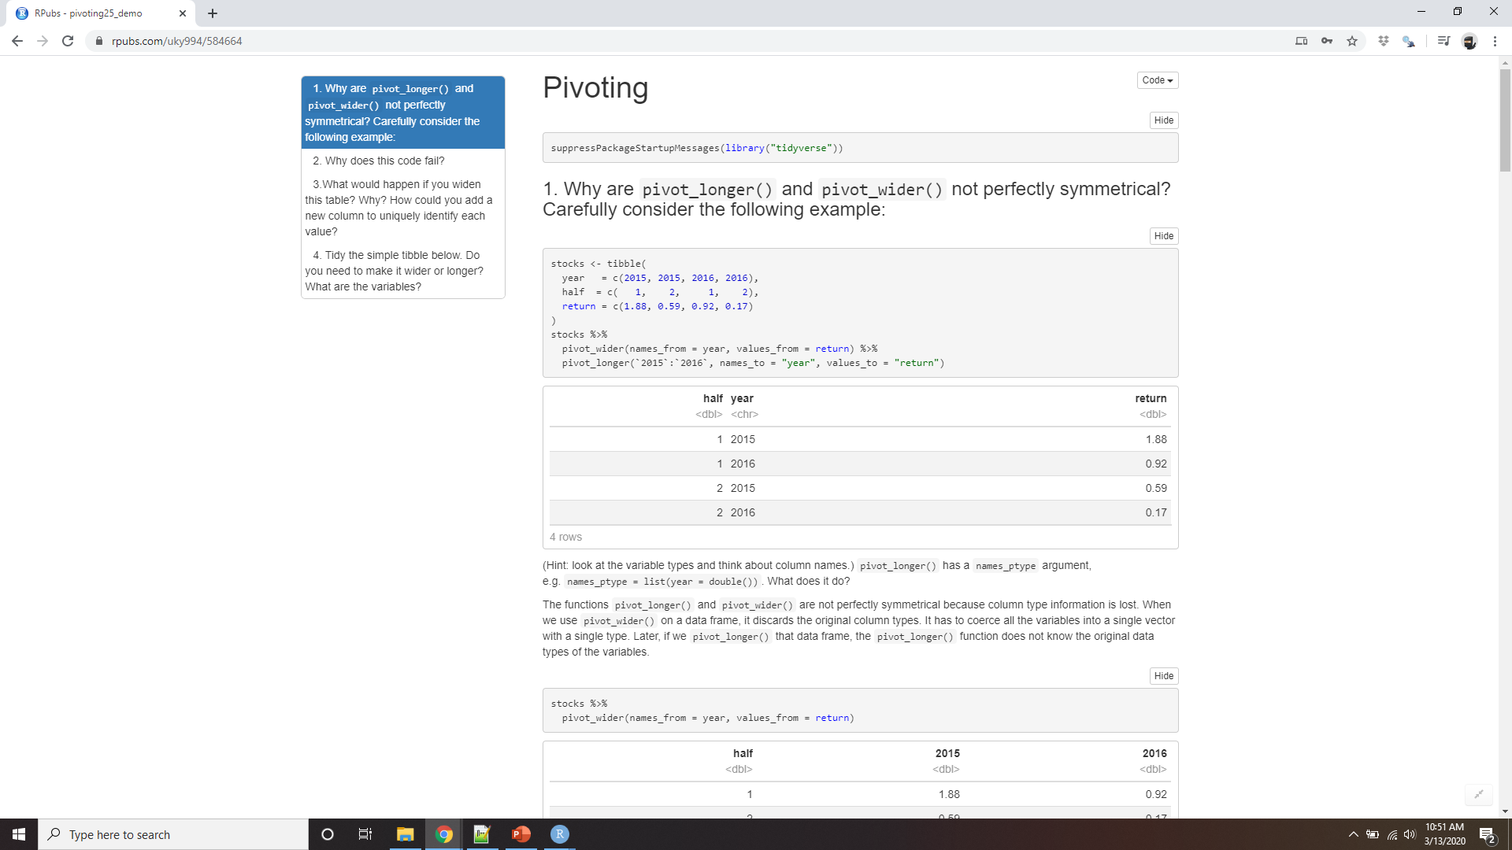
Demo pivoting
Notes:
https://rpubs.com/uky994/584664
Why are pivot_longer() and pivot_wider() not perfectly symmetrical? Carefully consider the following example:
stocks <- tibble( year = c(2015, 2015, 2016, 2016), half = c( 1, 2, 1, 2), return = c(1.88, 0.59, 0.92, 0.17) ) stocks %>% pivot_wider(names_from = year, values_from = return) %>% pivot_longer(`2015`:`2016`, names_to = "year", values_to = "return")
(Hint: look at the variable types and think about column names.)
pivot_longer() has a names_ptype argument, e.g. names_ptype = list(year = double()). What does it do?
Why does this code fail?
table4a %>% pivot_longer(c(1999, 2000), names_to = "year", values_to = "cases") #> Error in inds_combine(.vars, ind_list): Position must be between 0 and n
What would happen if you widen this table? Why? How could you add a new column to uniquely identify each value?
people <- tribble( ~name, ~names, ~values, #-----------------|--------|------ "Phillip Woods", "age", 45, "Phillip Woods", "height", 186, "Phillip Woods", "age", 50, "Jessica Cordero", "age", 37, "Jessica Cordero", "height", 156 )
Tidy the simple tibble below. Do you need to make it wider or longer? What are the variables?
preg <- tribble( ~pregnant, ~male, ~female, "yes", NA, 10, "no", 20, 12 )

Slide 20
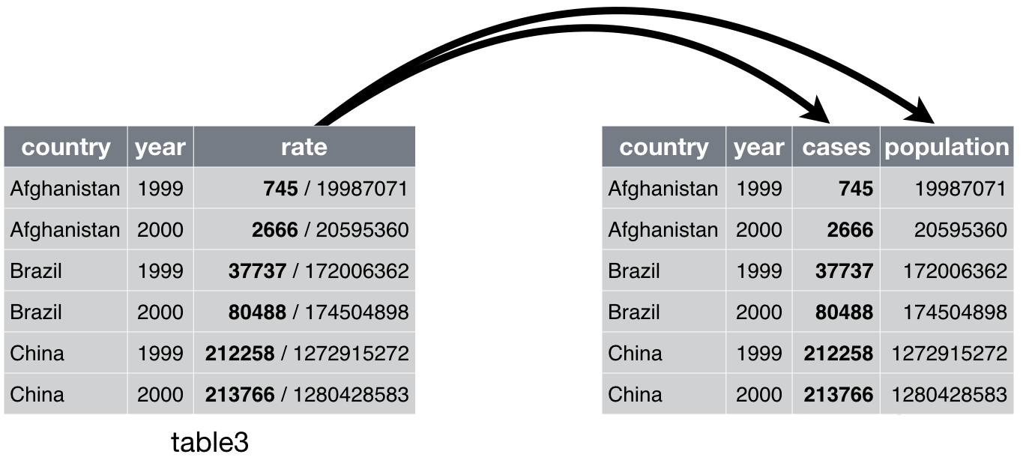
Separating and uniting
table3
#> # A tibble: 6 x 3
#> country year rate
#> * <chr> <int> <chr>
#> 1 Afghanistan 1999 745/19987071
#> 2 Afghanistan 2000 2666/20595360
#> 3 Brazil 1999 37737/172006362
#> 4 Brazil 2000 80488/174504898
#> 5 China 1999 212258/1272915272
#> 6 China 2000 213766/1280428583
cases
population
Notes:
So far you’ve learned how to tidy table2 and table4, but not table3. table3 has a different problem: we have one column (rate) that contains two variables (cases and population). To fix this problem, we’ll need the separate() function. You’ll also learn about the complement of separate(): unite(), which you use if a single variable is spread across multiple columns.

Slide 21
separate
separate() pulls apart one column into multiple columns, by splitting wherever a separator character appears.
table3 %>%
separate(rate, into = c("cases", "population"))
#> # A tibble: 6 x 4
#> country year cases population
#> <chr> <int> <chr> <chr>
#> 1 Afghanistan 1999 745 19987071
#> 2 Afghanistan 2000 2666 20595360
#> 3 Brazil 1999 37737 172006362
#> 4 Brazil 2000 80488 174504898
#> 5 China 1999 212258 1272915272
#> 6 China 2000 213766 1280428583
Notes:
The rate column contains both cases and population variables, and we need to split it into two variables. separate() takes the name of the column to separate, and the names of the columns to separate into, as shown in Figure and the code.

Slide 22
separate
table3 %>%
separate(rate, into = c("cases", "population"), sep = "/")
Notes:
By default, separate() will split values wherever it sees a non-alphanumeric character (i.e. a character that isn’t a number or letter). For example, in the code above, separate() split the values of rate at the forward slash characters. If you wish to use a specific character to separate a column, you can pass the character to the sep argument of separate(). For example, we could rewrite the code
(Formally, sep is a regular expression, which you’ll learn more about in strings.)

Slide 23
Convert = true
table3 %>%
separate(rate, into = c("cases", "population"))
#> # A tibble: 6 x 4
#> country year cases population
#> <chr> <int> <chr> <chr>
#> 1 Afghanistan 1999 745 19987071
#> 2 Afghanistan 2000 2666 20595360
#> 3 Brazil 1999 37737 172006362
#> 4 Brazil 2000 80488 174504898
#> 5 China 1999 212258 1272915272
#> 6 China 2000 213766 1280428583
table3 %>%
separate(rate, into = c("cases", "population"), convert = TRUE)
#> # A tibble: 6 x 4
#> country year cases population
#> <chr> <int> <int> <int>
#> 1 Afghanistan 1999 745 19987071
#> 2 Afghanistan 2000 2666 20595360
#> 3 Brazil 1999 37737 172006362
#> 4 Brazil 2000 80488 174504898
#> 5 China 1999 212258 1272915272
#> 6 China 2000 213766 1280428583
Notes:
Look carefully at the column types: you’ll notice that cases and population are character columns. This is the default behaviour in separate(): it leaves the type of the column as is. Here, however, it’s not very useful as those really are numbers. We can ask separate() to try and convert to better types using convert = TRUE:

Slide 24
sep
table3 %>% separate(year, into = c("century", "year"), sep = 2)
#> # A tibble: 6 x 4
#> country century year rate
#> <chr> <chr> <chr> <chr>
#> 1 Afghanistan 19 99 745/19987071
#> 2 Afghanistan 20 00 2666/20595360
#> 3 Brazil 19 99 37737/172006362
#> 4 Brazil 20 00 80488/174504898
#> 5 China 19 99 212258/1272915272
#> 6 China 20 00 213766/1280428583
Notes:
You can also pass a vector of integers to sep. separate() will interpret the integers as positions to split at. Positive values start at 1 on the far-left of the strings; negative value start at -1 on the far-right of the strings. When using integers to separate strings, the length of sep should be one less than the number of names in into.
You can use this arrangement to separate the last two digits of each year. This make this data less tidy, but is useful in other cases, as you’ll see in a little bit.

Slide 25
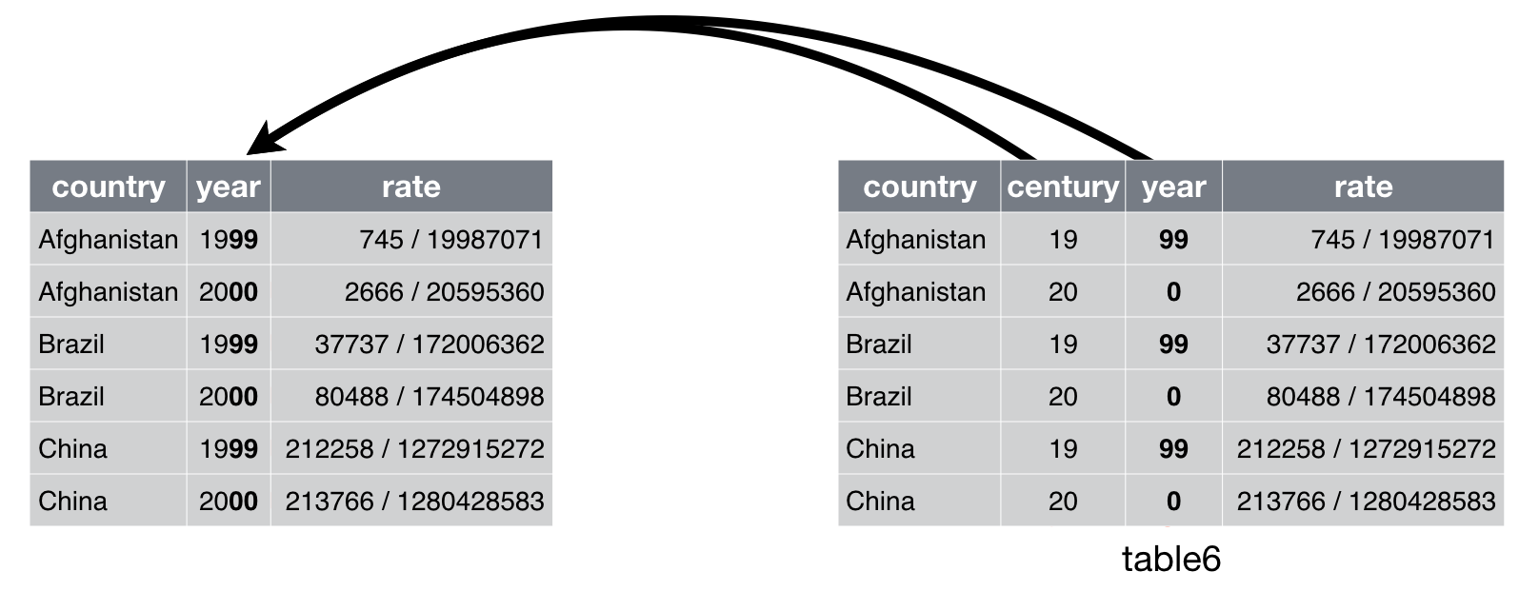
Unite
unite() is the inverse of separate(): it combines multiple columns into a single column
Notes:
unite() is the inverse of separate(): it combines multiple columns into a single column. You’ll need it much less frequently than separate(), but it’s still a useful tool to have in your back pocket.

Slide 26
unite
table5 %>% unite(new, century, year)
#> # A tibble: 6 x 3
#> country new rate
#> <chr> <chr> <chr>
#> 1 Afghanistan 19_99 745/19987071
#> 2 Afghanistan 20_00 2666/20595360
#> 3 Brazil 19_99 37737/172006362
#> 4 Brazil 20_00 80488/174504898
#> 5 China 19_99 212258/1272915272
#> 6 China 20_00 213766/1280428583
Notes:
We can use unite() to rejoin the century and year columns that we created in the last example. That data is saved as tidyr::table5. unite() takes a data frame, the name of the new variable to create, and a set of columns to combine, again specified in dplyr::select() style:

Slide 27
unite
table5 %>% unite(new, century, year, sep = "")
#> # A tibble: 6 x 3
#> country new rate
#> <chr> <chr> <chr>
#> 1 Afghanistan 1999 745/19987071
#> 2 Afghanistan 2000 2666/20595360
#> 3 Brazil 1999 37737/172006362
#> 4 Brazil 2000 80488/174504898
#> 5 China 1999 212258/1272915272
#> 6 China 2000 213766/1280428583
Notes:
In this case we also need to use the sep argument. The default will place an underscore (_) between the values from different columns. Here we don’t want any separator so we use "":

Slide 28
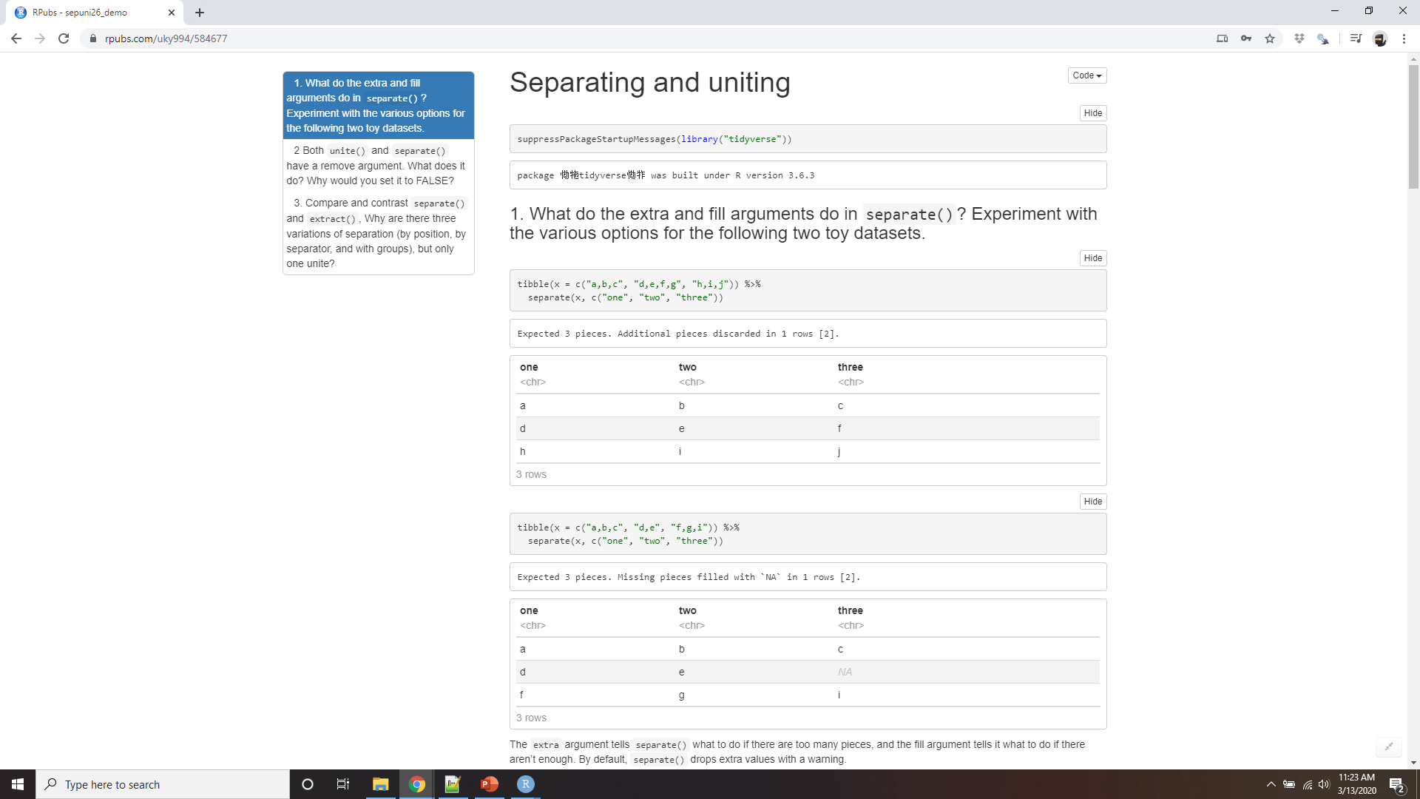
Demo separating and uniting
Notes:
https://rpubs.com/uky994/584677
What do the extra and fill arguments do in separate()? Experiment with the various options for the following two toy datasets.
tibble(x = c("a,b,c", "d,e,f,g", "h,i,j")) %>% separate(x, c("one", "two", "three")) tibble(x = c("a,b,c", "d,e", "f,g,i")) %>% separate(x, c("one", "two", "three"))
Both unite() and separate() have a remove argument. What does it do? Why would you set it to FALSE?
Compare and contrast separate() and extract(). Why are there three variations of separation (by position, by separator, and with groups), but only one unite?

Slide 29
Missing values
A value can be missing in one of two possible ways:
Explicitly, i.e. flagged with NA.
Implicitly, i.e. simply not present in the data.
Notes:
Changing the representation of a dataset brings up an important subtlety of missing values. Surprisingly, a value can be missing in one of two possible ways:
Explicitly, i.e. flagged with NA.
Implicitly, i.e. simply not present in the data.

Slide 30
Missing values
stocks <- tibble(
year = c(2015, 2015, 2015, 2015, 2016, 2016, 2016),
qtr = c( 1, 2, 3, 4, 2, 3, 4),
return = c(1.88, 0.59, 0.35, NA, 0.92, 0.17, 2.66)
)
Where’s 1?
Notes:
Let’s illustrate this idea with a very simple data set:
There are two missing values in this dataset:
The return for the fourth quarter of 2015 is explicitly missing, because the cell where its value should be instead contains NA.
The return for the first quarter of 2016 is implicitly missing, because it simply does not appear in the dataset.
One way to think about the difference is with this Zen-like koan: An explicit missing value is the presence of an absence; an implicit missing value is the absence of a presence.
Where’s 1?

Slide 31
Missing values
stocks %>%
pivot_wider(names_from = year, values_from = return)
#> # A tibble: 4 x 3
#> qtr `2015` `2016`
#> <dbl> <dbl> <dbl>
#> 1 1 1.88 NA
#> 2 2 0.59 0.92
#> 3 3 0.35 0.17
#> 4 4 NA 2.66
Notes:
The way that a dataset is represented can make implicit values explicit. For example, we can make the implicit missing value explicit by putting years in the columns:

Slide 32
values_drop_na = TRUE
stocks %>%
pivot_wider(names_from = year, values_from = return) %>%
pivot_longer(
cols = c(`2015`, `2016`),
names_to = "year",
values_to = "return",
values_drop_na = TRUE
)
#> # A tibble: 6 x 3
#> qtr year return
#> <dbl> <chr> <dbl>
#> 1 1 2015 1.88
#> 2 2 2015 0.59
#> 3 2 2016 0.92
#> 4 3 2015 0.35
#> 5 3 2016 0.17
Notes:
Because these explicit missing values may not be important in other representations of the data, you can set values_drop_na = TRUE in pivot_longer() to turn explicit missing values implicit:

Slide 33
complete()
stocks %>%
complete(year, qtr)
#> # A tibble: 8 x 3
#> year qtr return
#> <dbl> <dbl> <dbl>
#> 1 2015 1 1.88
#> 2 2015 2 0.59
#> 3 2015 3 0.35
#> 4 2015 4 NA
#> 5 2016 1 NA
#> 6 2016 2 0.92
#> # … with 2 more rows
Notes:
Another important tool for making missing values explicit in tidy data is complete():
complete() takes a set of columns, and finds all unique combinations. It then ensures the original dataset contains all those values, filling in explicit NAs where necessary.

Slide 34
Fill()
treatment <- tribble(
~ person, ~ treatment, ~response,
"Derrick Whitmore", 1, 7,
NA, 2, 10,
NA, 3, 9,
"Katherine Burke", 1, 4
)
Notes:
There’s one other important tool that you should know for working with missing values. Sometimes when a data source has primarily been used for data entry, missing values indicate that the previous value should be carried forward:

Slide 35
Fill()
treatment %>%
fill(person)
#> # A tibble: 4 x 3
#> person treatment response
#> <chr> <dbl> <dbl>
#> 1 Derrick Whitmore 1 7
#> 2 Derrick Whitmore 2 10
#> 3 Derrick Whitmore 3 9
#> 4 Katherine Burke 1 4
Notes:
You can fill in these missing values with fill(). It takes a set of columns where you want missing values to be replaced by the most recent non-missing value (sometimes called last observation carried forward).

Slide 36
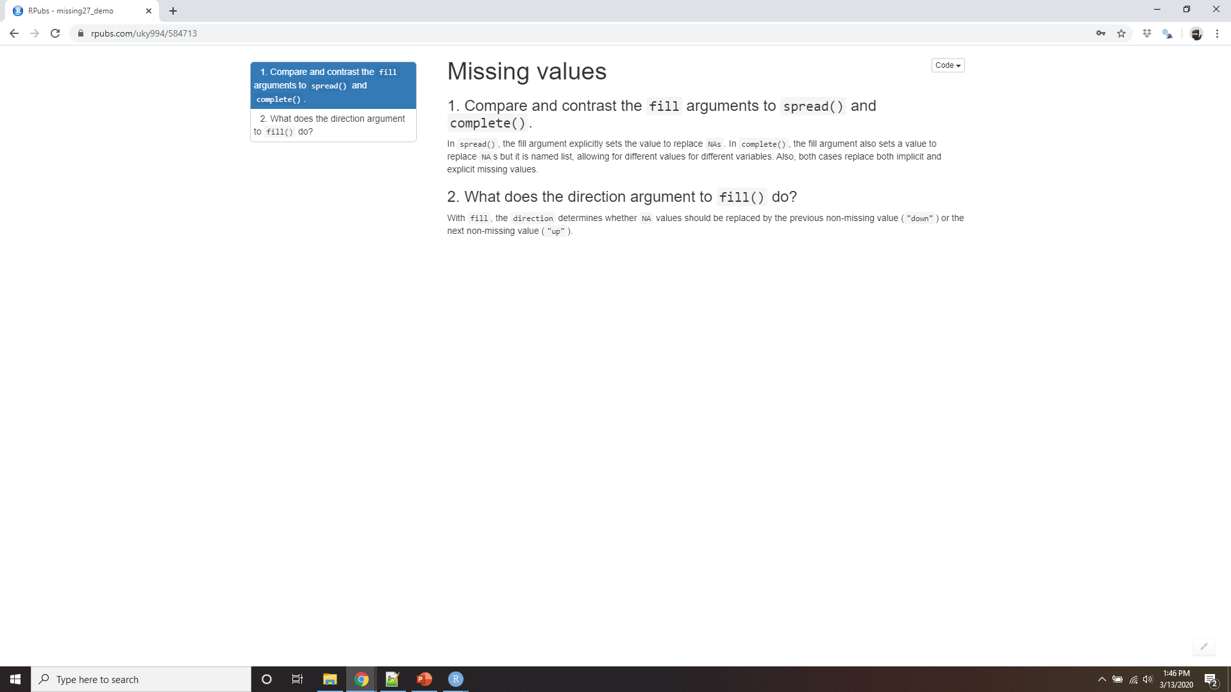
Demo missing values
Notes:
https://rpubs.com/uky994/584713
Compare and contrast the fill arguments to pivot_wider() and complete().
What does the direction argument to fill() do?
Case Study: https://rpubs.com/uky994/584719

Slide 37
Non-tidy data
There are lots of useful and well-founded data structures that are not tidy data
There are two main reasons to use other data structures:
performance or space advantages.
evolved their own conventions
Tidy data should be your default choice
For more info http://simplystatistics.org/2016/02/17/non-tidy-data/
Notes:
Before we continue on to other topics, it’s worth talking briefly about non-tidy data. Earlier in the chapter, I used the pejorative term “messy” to refer to non-tidy data. That’s an oversimplification: there are lots of useful and well-founded data structures that are not tidy data. There are two main reasons to use other data structures:
Alternative representations may have substantial performance or space advantages.
Specialised fields have evolved their own conventions for storing data that may be quite different to the conventions of tidy data.
Either of these reasons means you’ll need something other than a tibble (or data frame). If your data does fit naturally into a rectangular structure composed of observations and variables, I think tidy data should be your default choice. But there are good reasons to use other structures; tidy data is not the only way.
If you’d like to learn more about non-tidy data, I’d highly recommend this thoughtful blog post by Jeff Leek: http://simplystatistics.org/2016/02/17/non-tidy-data/

